Slide 1

Digital Literacy
Abdul Wahab Aslam (02-131222-132)
Muhammad Buland Bakht (02-131222-128)
Abdullah (02-131222-099)

Slide 2


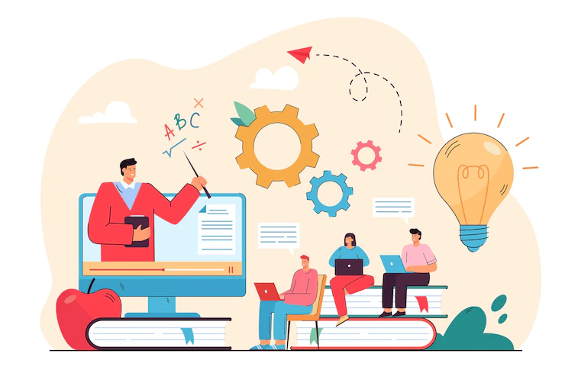
What is digital literacy?
Digital literacy refers to the ability to use digital technologies effectively and responsibly to access, evaluate, create, and communicate information. It encompasses a range of technical skills, cognitive knowledge, and attitudes required to navigate the digital world and participate in the digital age.

Slide 3

Why does Digital literacy Matter?
Digital literacy is increasingly important in today’s digital world, as it enables individuals to participate fully in society and the economy. It can also help to bridge the digital divide, which refers to the gap between those who have access to digital technologies and those who do not.
Digital literacy encompasses a vast collection of skills that help users utilize digital tools to the fullest through finding, creating, sharing, and evaluating information.

Slide 4
Cont…
Digital literacy is crucial as technology increasingly permeates all aspects of our lives, from education and employment to communication and social interaction.
Digital literacy has become crucial in functioning critically and effectively in the now-digital world, which is why we should encourage teaching and learning digital skills for all ages. The lifelong skills enables one to use digital platforms thoughtfully and responsibly, to apply skills across different media and applications and be able to manage digital footprint in a positive manner.

Slide 5

“People’s interaction with digital technologies are multiple, rich and complex; there is a wide array of practices involved in digital literacy.”
(HAGUE & PAYTON, 2021)

Slide 6
Key components of digital literacy
Digital literacy comprises several important components that enable individuals to navigate the digital landscape with confidence. These components are:
Information Literacy.
Communication & Collaboration.
Media Literacy.
Privacy & Security.

Slide 7
Challenges
Time Management
Technological Difficulties
Less Interpersonal Communication
Strengths
Knowledge construction
Good Digital Citizenship
Communication and Collaboration

Slide 8
6C’s of Digital Literacy
Character
Critical thinking
Communication
Collaboration
Creativity
Citizenship

Slide 9
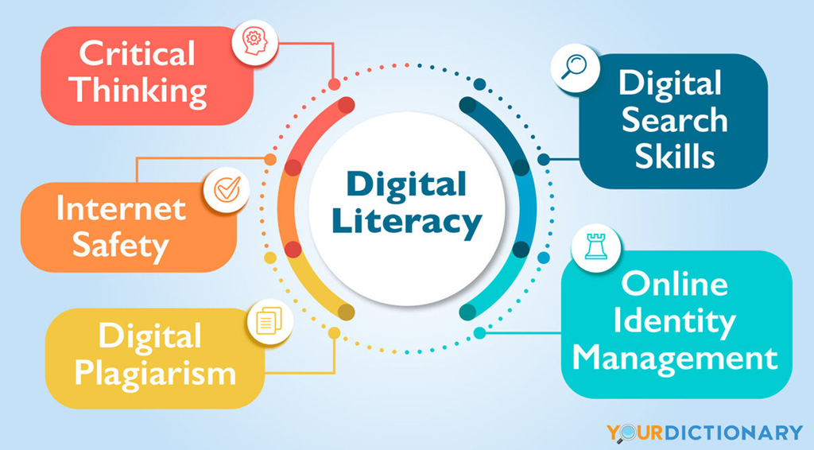

Slide 10
Conclusion
Digital Literacy is about more than just using computers. To become digitally literate, people need to develop a range of skills. We need to be able to use technology to search for and create content, solve problems, and innovate. We need to be able to connect and communicate effectively online, learn, collaborate with peers, and discover and share new information. While doing all of this, we need to be able to recognize risk, stay safe online, protect their physical and emotional wellbeing, and practice positive online behaviors.

Slide 11
References
https://www.cambridge.org/elt/blog/2022/04/07/understanding-developing-digital-literacy/
https://www.westernsydney.edu.au/studysmart/home/study_skills_guides/digital_literacy/what_is_digital_literacy
https://potomac.edu/what-is-digital-literacy/
https://thedigitalfury.com/what-is-digital-literacy/

Slide 12
Thank You

